Slide 1
APACHE LUCENE

Slide 2
INTRODUCTION
Apache Lucene is a freely available information retrieval software library that works with fields of text within document files. This evolving venture is also called the Apache Lucene Project. Apache is a server that is distributed under an open sourcelicense.
The Lucene application program interface (API) stays the same regardless of the format of the file to be indexed. Provided that the text information can be recovered and extracted, Lucene can index practically any type of text-containing document. Lucene has become popular for use in Internet search engines as well as for single-site search operations.

Slide 3
APACHE LUCENE PROJECT
The Apache Lucene Project comprises four main components:
Lucene Core: Indexing, searching, spell checking, hit highlighting, and tokenization.
PyLucene: Pythonport for Lucene Core.
Solr: Extensible Markup Language (XML), Hypertext Transfer Protocol (HTTP), and APIs for Javascript Object Notation (JSON), Python, and Ruby, as well as hit highlighting, faceted search, caching, replication, and an interface for Web site administrators.
Open Relevance Project: Free distribution of materials for performance testing and relevance evaluation.

Slide 4
FEATURES
Scalable, High-Performance Indexing
over 150GB/hour on modern hardware
small RAM requirements -- only 1MB heap
Powerful, Accurate and Efficient Search Algorithms
multiple-index searching with merged results
allows simultaneous update and searching
Cross-Platform Solution
100%-pure Java
Implementations in other programming languages available that are index-compatible

Slide 5
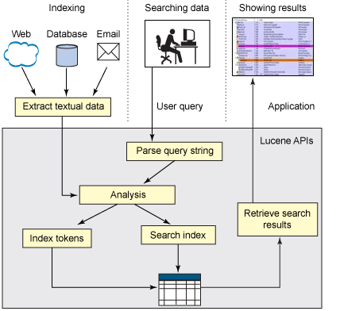
APPLICATIONS

Slide 6
APPLICATIONS
Building applications using Lucene
As shown in Figure 1, building a full-featured search application using Lucene primarily involves indexing data, searching data, and displaying search results
The example application indexes a set of e-mail documents stored in properties files and shows how to use Lucene's query APIs to search an index. The example will also familiarize you with basic index operations.

Slide 7
INDEXWRITER
IndexWriter creates an index of documents.
IndexWriter writer=new IndexWriter(INDEX_DIR , new StandardAnalyzer(),true);
First argument is a directory of where to build /find the index.
Second argument calls an Analyzer.
Third argument determines if a new index should be created.

Slide 8
StandardAnalyzer
StandardAnalyzer tokenizes the text based on European language grammars sets everything to lower case and removes English stop words (i.e. “the” “an”….etc.)
The StandardAnalyzer should be same for both indexing and searching files in the directory.

Slide 9
Adding Documents.
After creating index, next step is adding documents.
Writer.addDocument( FileDocument.Document (file));
Now assign tokens/doc ID
Create some type of loop to add all the documents.

Slide 10
Searching an index
Mainly search can be done in two ways. They are
Streaming
paging
To run search on Index ,IndexSearcher object is used.
Searcher searcher= new IndexSearcher(reader);
For searching also same analyzer is used.

Slide 11
Creating Query
Parse/create query
Query query= QueryParser.Parse ( line,field,analyzer);
Takes a line ,looks for a particular field, and runs it through an analyzer to create query.
Determines which documents are matches
Hits hits = Searcher. search(query);

Slide 12
Retrieving documents
HITS creates a collection of documents.
By using loop we can reference each doc
Document doc = hits.doc(i);
This allows us to get info about document i.e.
Name of document, Date it was created, Words in document.

